Slide 1
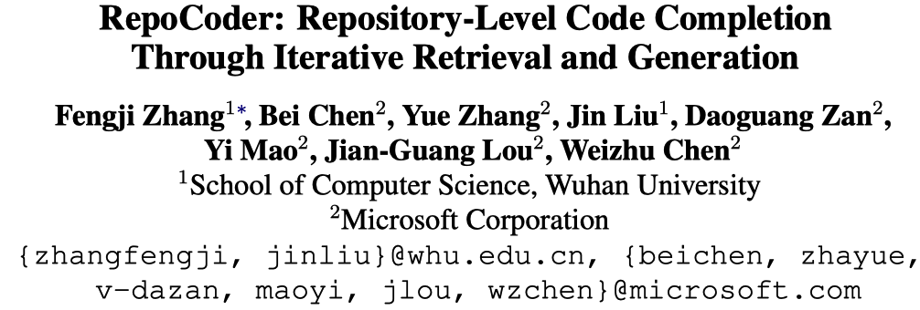
arXiv
Notes:
今天给大家汇报一篇repository-level代码补全的文章，作者来自武汉大学和微软，目前挂在arXiv上

Slide 2
Abstract
Motivation
Repository-level code completion aims to complete the unfinished code based on a broader context of the repository.
Existing approaches are general and are hard to generalize to unseen and customized repositories.
Contribution
RepoCoder¹ – a approach for repository-level code completion.
RepoCoder utilizes a novel iterative retrieval-generation paradigm.
RepoEval¹ – a repository-level code completion benchmark.
Extensive experiments and discussion.
1. The model and benchmark have been open-sourced.
Notes:
本文要研究的问题是repository-level的代码补全，它是指…
但现有的方法主要适用于general场景，难以很好地泛化到…
本文针对这一点进行探索，主要有四点贡献：…

Slide 3
Introduction
Code completion
Given a unfinished code snippet, generating the following code.
Repository-level code completion
Code files within a repository often have interrelated dependencies (e.g., utilities, APIs).
Taking the broader context in a repository as addition inputs.
Notes:
首先大致介绍一些代码补全
后续，研究者们发现同一个repository内的代码文件存在很多内部依赖。这些依赖对于真实场景下的代码补全来说至关重要。…

Slide 4
Introduction
Code completion
Given a unfinished code snippet, generating the following code.
Repository-level code completion
Code files within a repository often have interrelated dependencies (e.g., utilities, APIs).
Taking the broader context in a repository as addition inputs.
Related work – Language models
A repository often contains many code files, including thousands of lines.
While language models have limited input lengths.
Notes:
目前在代码补全上的主流方法是语言模型。但…

Slide 5
Introduction
Code completion
Given a unfinished code snippet, generating the following code.
Repository-level code completion
Code files within a repository often have interrelated dependencies (e.g., utilities, APIs).
Taking the broader context in a repository as addition inputs.
Related work – Language models
A repository often contains many code files, including thousands of lines.
While language models have limited input lengths.
How to extract relevant context from the repository?
Notes:
因此，本文认为repository-level的代码补全，关键在于如何…

Slide 6
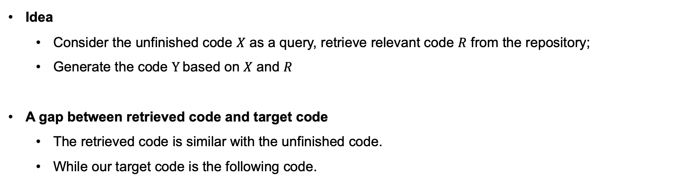
Approach
Idea
Consider the unfinished code $X$ as a query, retrieve relevant code $R$ from the repository;
Generate the code $Y$based on $X$ and $R$
A gap between retrieved code and target code
The retrieved code is similar with the unfinished code.
While our target code is the following code.
Notes:
本文的idea很简单，就是基于上文在repository里检索出一些相关的代码片段…
但在检索过程中，存在一个明显的gap…

Slide 7
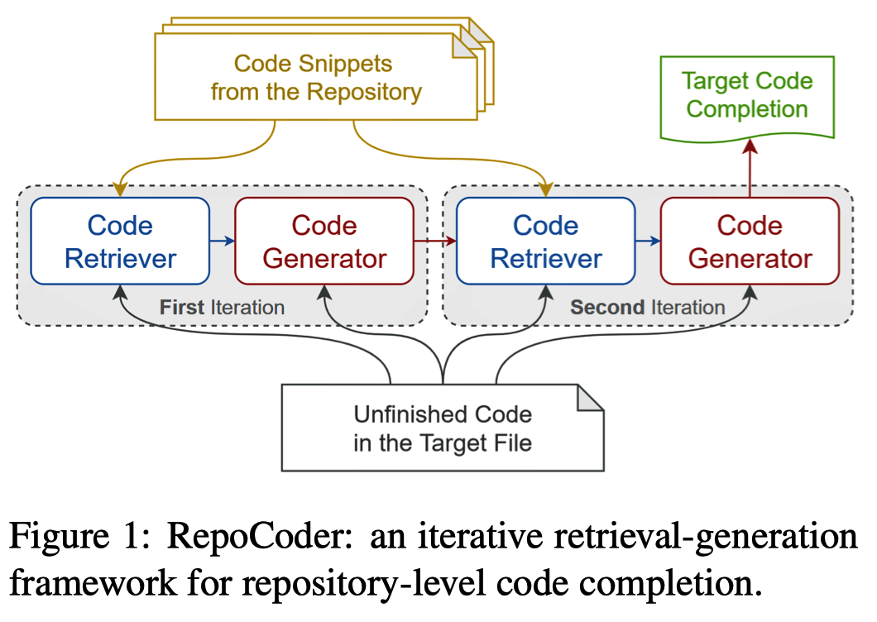
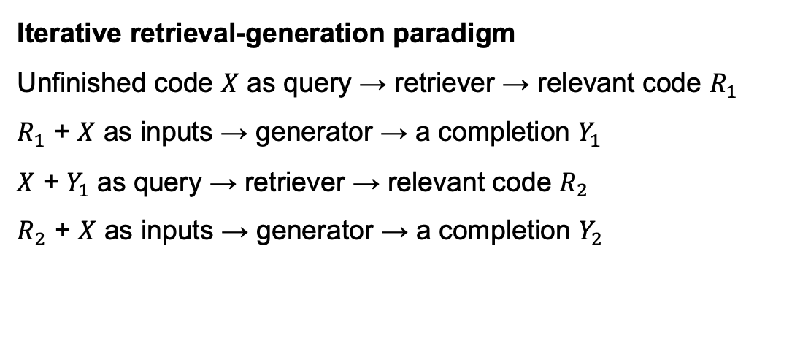
Approach
Iterative retrieval-generation paradigm
Unfinished code $X$ as query → retriever → relevant code $R_{1}$
$R_{1}$ + $X$ as inputs → generator → a completion $Y_{1}$
$X$ + $Y_{1}$as query → retriever → relevant code $R_{2}$
$R_{2}$ + $X$ as inputs → generator → a completion $Y_{2}$
First iteration
Second iteration
Notes:
为了关键这个gap，本文提出了一种迭代式的检索-生成范式。下面详细讲一下。
本文方法包括两轮迭代过程。
第一次迭代...
第二次迭代...
这里作者的motivation是：第一轮迭代，模型可以生成一个形式上良好，内容上可能存在错误的补全结果。我们可以拿这个结果增强第二轮的retrieval，从而得到与目标代码更相关的相似代码，之后再进一步生成。

Slide 8
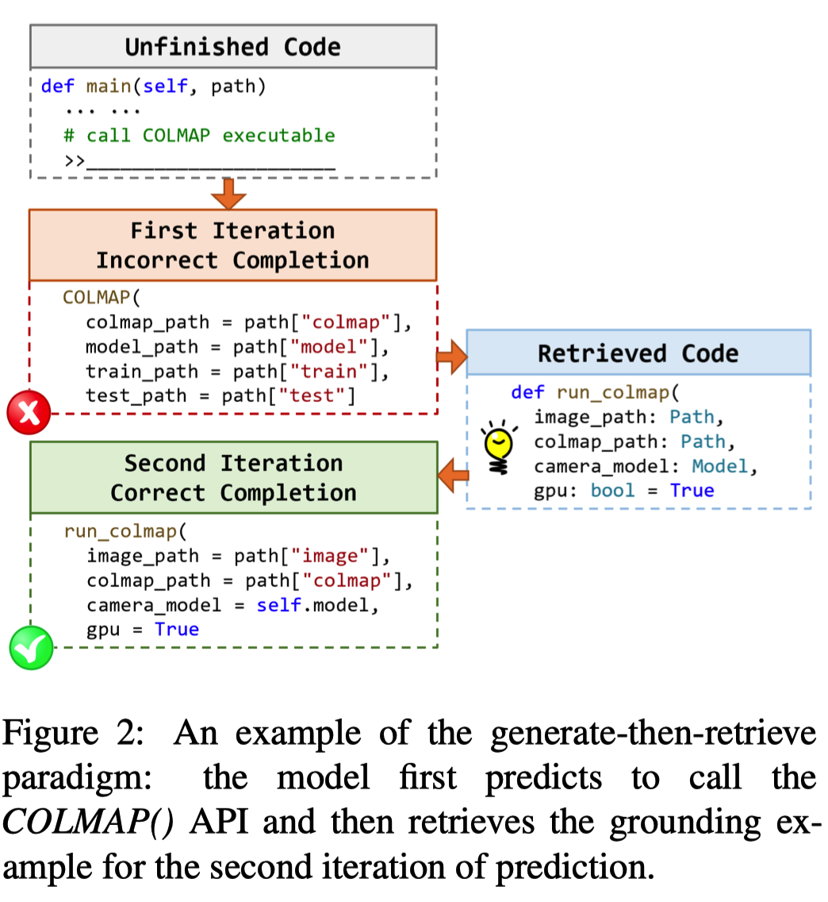




Approach
Iterative retrieval-generation paradigm
Unfinished code $X$ as query → retriever → relevant code $R_{1}$
$R_{1}$ + $X$ as inputs → generator → a completion $Y_{1}$
$X$ + $Y_{1}$as query → retriever → relevant code $R_{2}$
$R_{2}$ + $X$ as inputs → generator → a completion $Y_{2}$
$$X$$
First iteration
$$Y_{1}$$
Second iteration
$$R_{2}$$
$$Y_{2}$$
Notes:
右侧展示了一个例子…其中Y1虽然存在错误，但是也大致反应了目标代码的形式，可以用于增强后续的生成

Slide 9
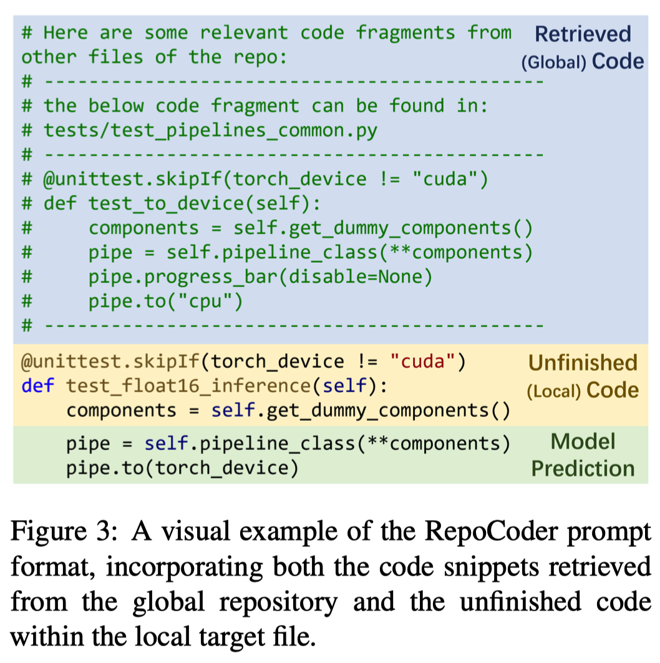



Approach
$$R_{2}$$
$$X$$
$$Y_{2}$$
Notes:
这里展示了，RepoCoder在生成最终代码时的prompt，
可以看出，这里检索到的代码中包含很多相关的信息，有利于当前位置的预测

Slide 10
Implementation details
Retrieval
Retrieval corpus is built by partitioning the repository code ﬁles into a set of code snippets with a sliding window.
Retriever: Jaccard-similarity, and Text-Embedding-Ada-002 (OpenAI)
Extract Top-K retrieved code snippets as outputs
Generator
A pre-trained language model: CodeGen (350M/2B/6B), Code-Davinci-002
Prompt. Retrieved code snippets are concatenated to the unfinished code
Zero-shot inference
Notes:
本文方法的大致流程就结束了，比较简单，一句话概括就是：通过一个两轮的检索来提取repository中相关的代码片段，再作为prompt增强代码补全。
这里是一些具体的实现细节…

Slide 11
Benchmark
RepoEval
A benchmark for repository-level code completion
Line completion
Randomly select 1600 lines from 8 GitHub repositories
Non-repetitive, not code comments, and each line contains >5 tokens
API Invocation completion
1600 intra-repository API invocations from 8 GitHub repositories
Non-repetitive
Function body completion
Randomly select 455 functions from 8 GitHub repositories
Each function has 3 to 30 lines of code to complete.
Notes:
为了衡量RepoEval的性能，作者自己构造一个repository-level的代码补全benchmark，其中包括三类补全。

Slide 12
Metric
RepoEval
Line and API invocation completion
Exact Match (EM), Edit Similarity based on Levenshtein distance (ES)
Function body completion
Pass Rate (PR) = Pass@1
For all metrics, higher values are better.
Notes:
评估指标方面…

Slide 13
Baseline
Zero-shot
Zero-shot inference using the generator = without retrieval
RG-1
Only with first retrieval-generation iteration
Oracle
Directly perform the second retrieval-generation iteration
Retrieval query: several lines of target code + unfinished code
Notes:
实验包括三个baseline

Slide 14
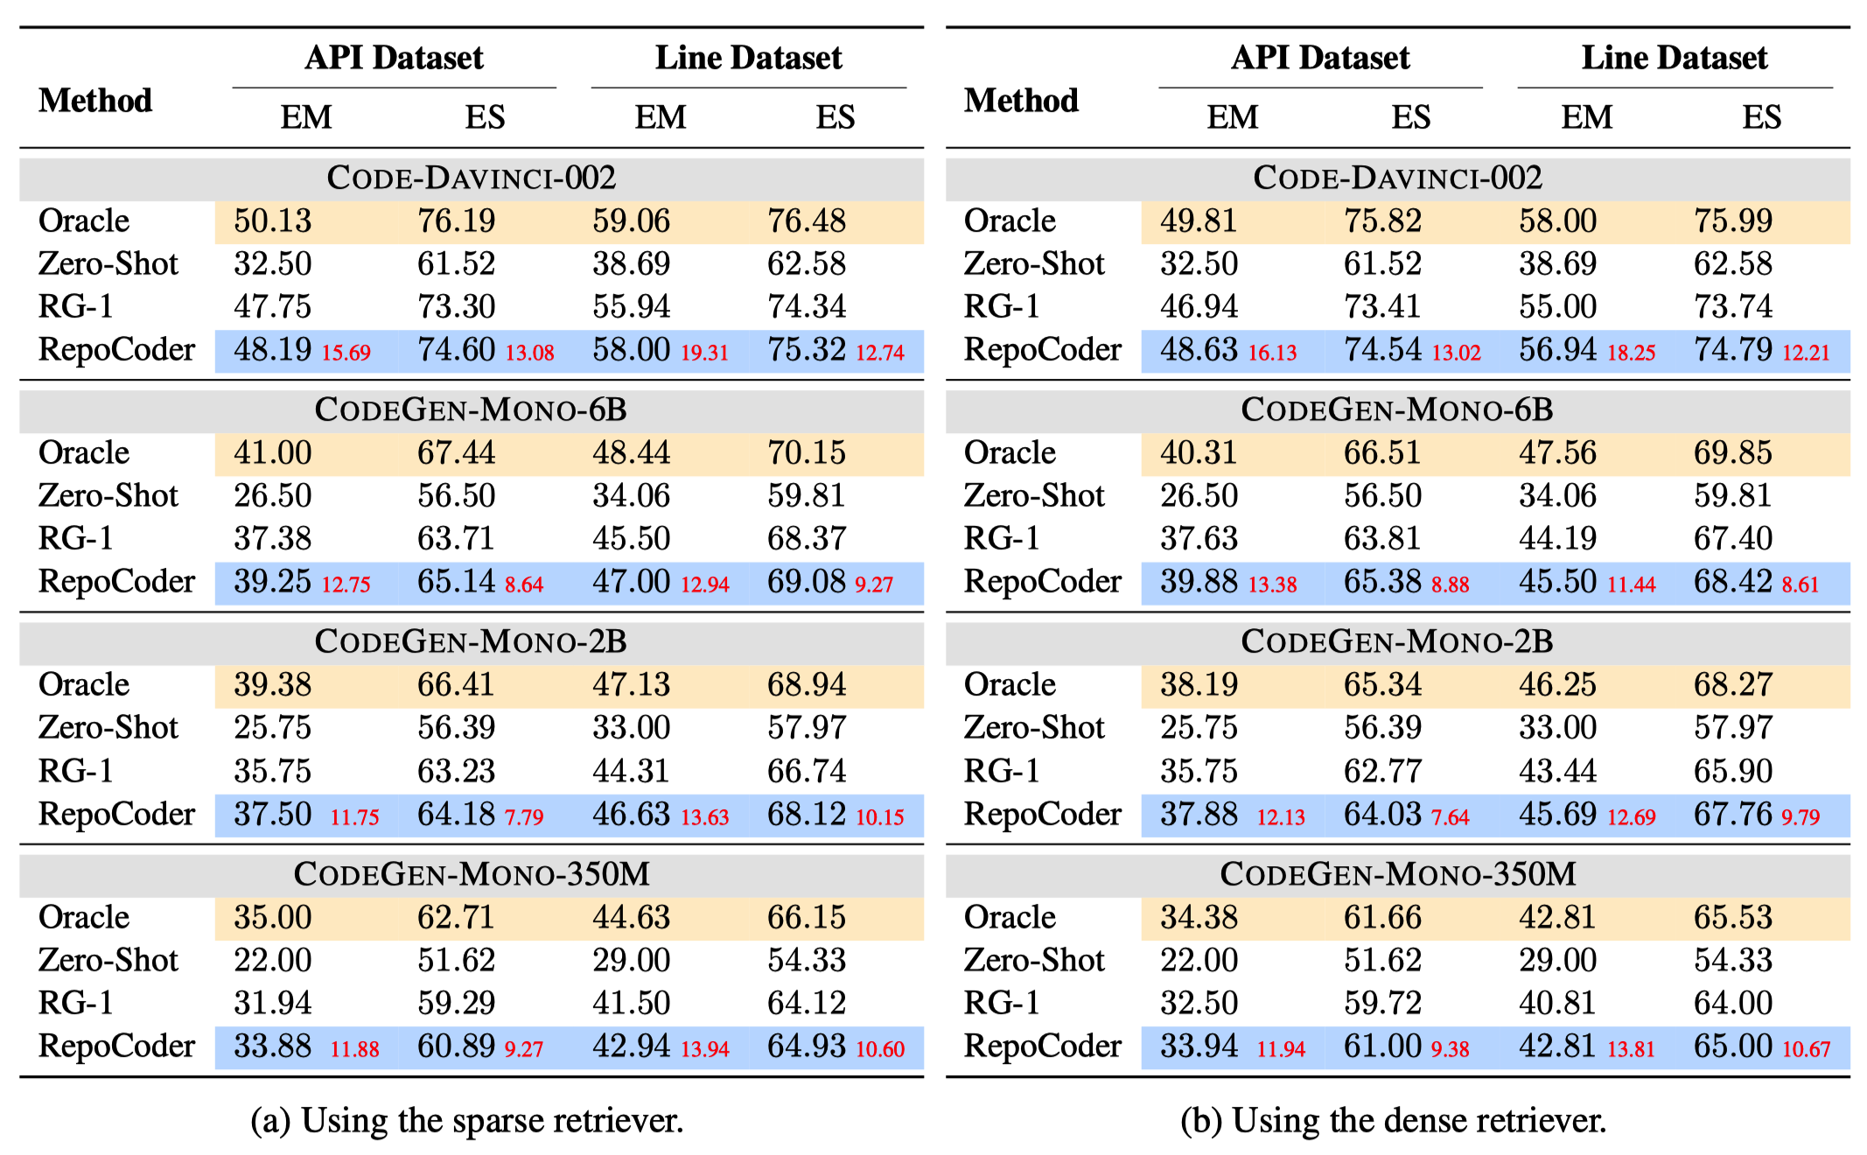
Results on Line&API Completion
Compared to zero-shot, RepoCoder achieves significant improvements.
Compared to RG-1, RepoCoder brings slight improvements.
Jaccard-similarity
Text-Embedding-Ada-002
Notes:
这里展示的是RepoCoder在行级别和API级别上的补全结果。
左边的表格是使用…
其中又具体分为多个generator的结果
从实验结果可以看出…

Slide 15
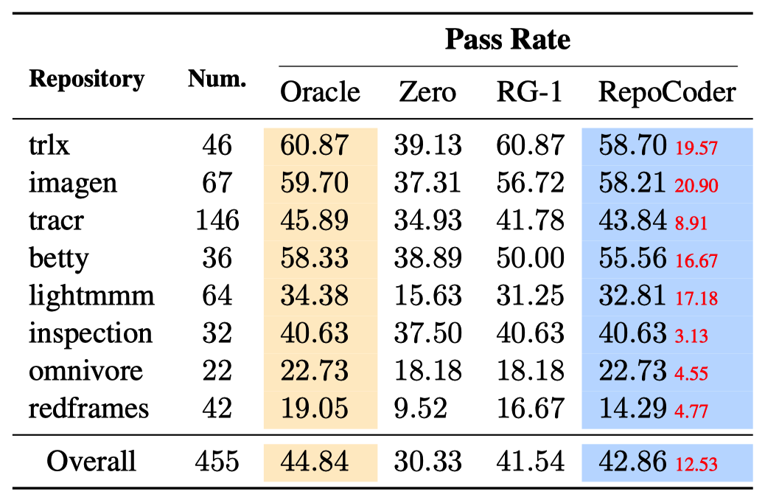
Results on Function Body Completion
RepoCoder consistently outperforms zero-shot baselines, but is sometimes weaker than RG-1.
RepoCoder: Jaccard-similarity Retriever + Code-Davinci-002
Notes:
之后是在方法体补全上的效果。第一列是…

Slide 16
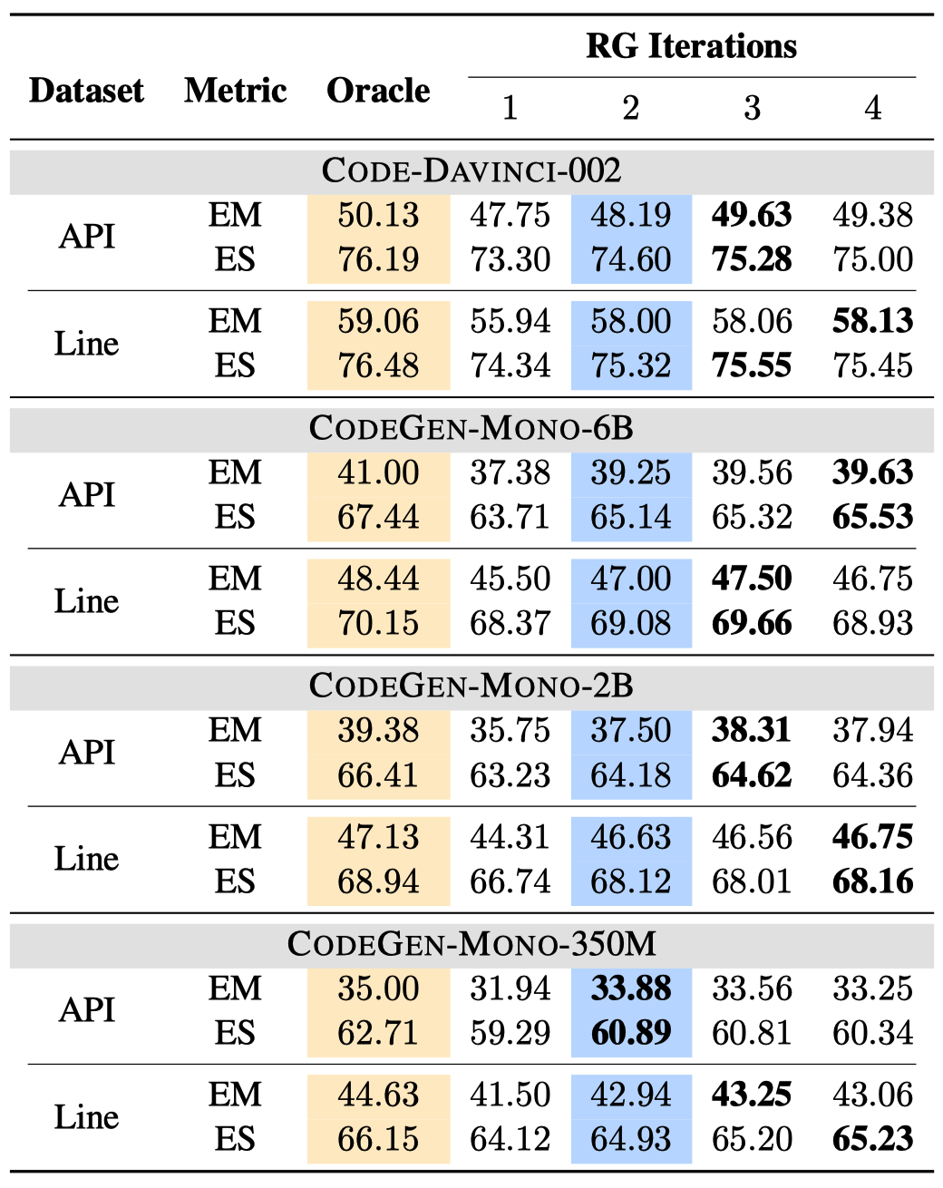
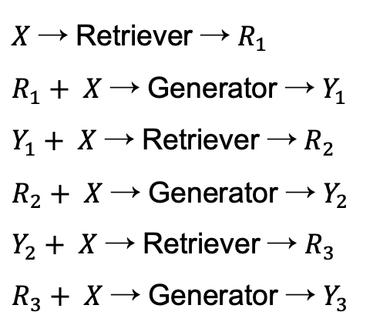
Discussion – More Iteration
RepoCoder
$X$ → Retriever → $R_{1}$
$R_{1}+ X$ → Generator → $Y_{1}$
$Y_{1}+ X$ → Retriever → $R_{2}$
$R_{2}+ X$ → Generator → $Y_{2}$
$Y_{2}+ X$ → Retriever → $R_{3}$
$R_{3}+ X$ → Generator → $Y_{3}$
RG-1
RG-2
RG-3
….
As number of iterations increases, the performance does not continue to improve.
Notes:
之后作者进行了大量的讨论。首先是迭代轮数的问题，案例来说，本文的方法可以一直这么迭代下去。
左侧给了几个例子
右侧是不同迭代轮数的实验结果。
可以看出，增加迭代轮数并不会稳定地提升效果。

Slide 17
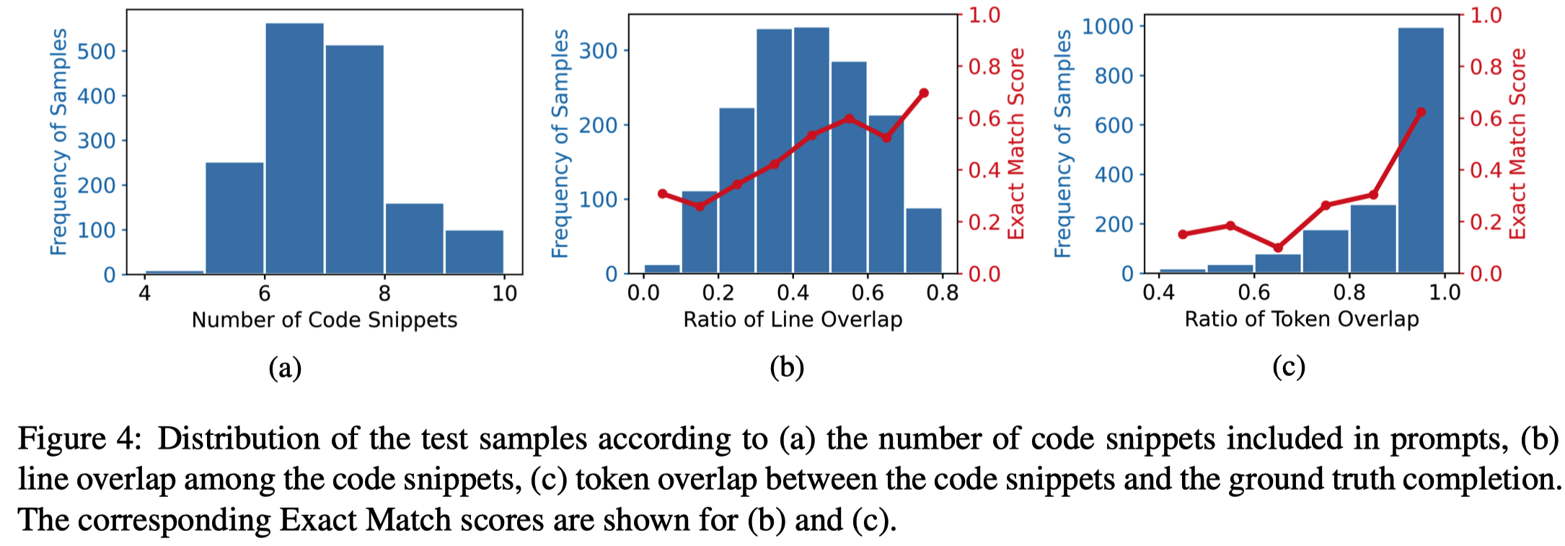
Discussion – Retrieved Code
A positive correlation between intra-overlap in retrieved code snippets and performance of RepoCoder.
Most of retrieved code snippets have over 70% token overlap against the ground-truths.
Notes:
作者也对检索出的代码进行了分析。
图a是prompt中拼接的相似代码数量分布。作者按照语言模型的最大输入长度去拼接尽可能多的检索结果。…
图b是检索的代码段之间的重合度。例如，…，红色的是对应样本上RepoCoder的效果波动。可以发现，二者之间有一定的正相关。这可能是因为，重复度越高的代码片段，说明它在当前repository内经常被复用，自然有更高的概率出现在当前待补全的位置。
图c是检索代码和目标代码之间的token重合度，红色的线是RepoCoder在对应样本上的效果波动。可以发现…

Slide 18
Discussion – Context Locations
Authors extract uniquely success cases of RepoCoder and extract their retrieved code.
Classify retrieved code into five locations:
Imported. Code from a ﬁle imported by the target ﬁle
Current File. Code from the excluded content of the target ﬁle
Current Directory. Code from a ﬁle in the same directory as the target ﬁle
Similar Import. Code from a ﬁle sharing at least one intra-project API with the target ﬁle
Similar Name. Code from a ﬁle with a ﬁle name sharing at least one token with the target ﬁle
Notes:
之后，作者还分析这些检索得到的代码，都来自repository哪些位置。
作者提取出RepoCoder成功但baselines失败的例子，然后对这些样本所设计的检索代码进行分类。
大致上分为五类：…

Slide 19
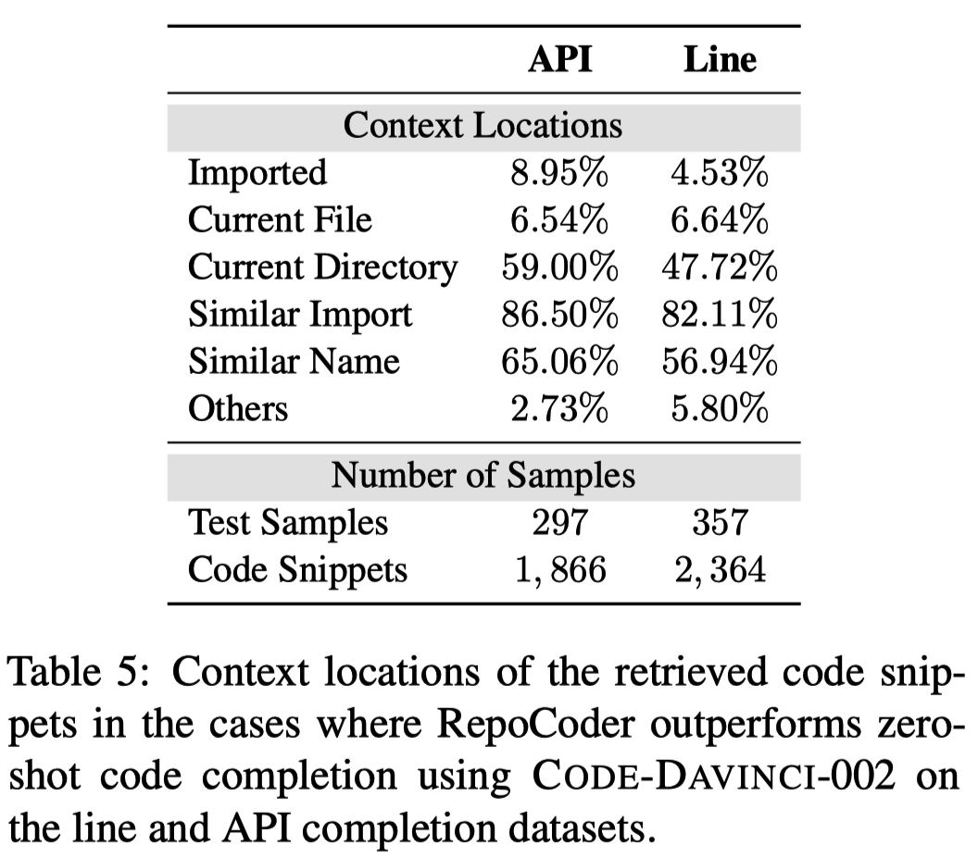
Discussion – Context Locations
The majority of code snippets originate from ﬁles with “Similar Import”, “Similar Name”, or “Current Directory” locations.
Notes:
左侧表格就是分类的结果。可以看出，大部分的检索结果是来自于当前文件夹的其他文件、或者是具有相似import和命名的文件。这个现象感觉也比较好理解，我们自己写代码的时候，也经常把一些函数包装起来，放在一个文件内，然后其他文件再调用。同理，如果两个文件的import相似或者命名相似，那它们可能是解决相似问题的程序，之间也会存在一些相同的代码。

Slide 20
Discussion – Case Study
Authors manually observed cases and found two phenomenons.
A majority failed cases are caused by wrong code retrievals.
Retrieved code snippets conflict with the local context, leading to incorrect predictions.
Language models are highly sensitive to the given prompts.
Small variations in the order of code snippets can lead to unexpected predictions.

Slide 21
Conclusion
A simple and effective framework – RepoCoder for repository-level code completion.
Through iterative retrieval and generation, RepoCoder consider more global context into code completion.
Extensive experiments on a repository-level code completion benchmark – RepoEval show the effectiveness of RepoCoder.

Slide 22
Conclusion
A simple and effective framework – RepoCoder for repository-level code completion.
Through iterative retrieval and generation, RepoCoder consider more global context into code completion.
Extensive experiments on a repository-level code completion benchmark – RepoEval show the effectiveness of RepoCoder.
My comments.
Repository-level code completion – a important research topic
RepoCoder - a retrieval-augmented code completion model
The Generation-augmented retrieval is interesting and can be further explored.

